Slide 1
School Performance and Geography
Josh Carson & Evan Kramer | Data Governance and Accountability
Notes:
Evan

Slide 2
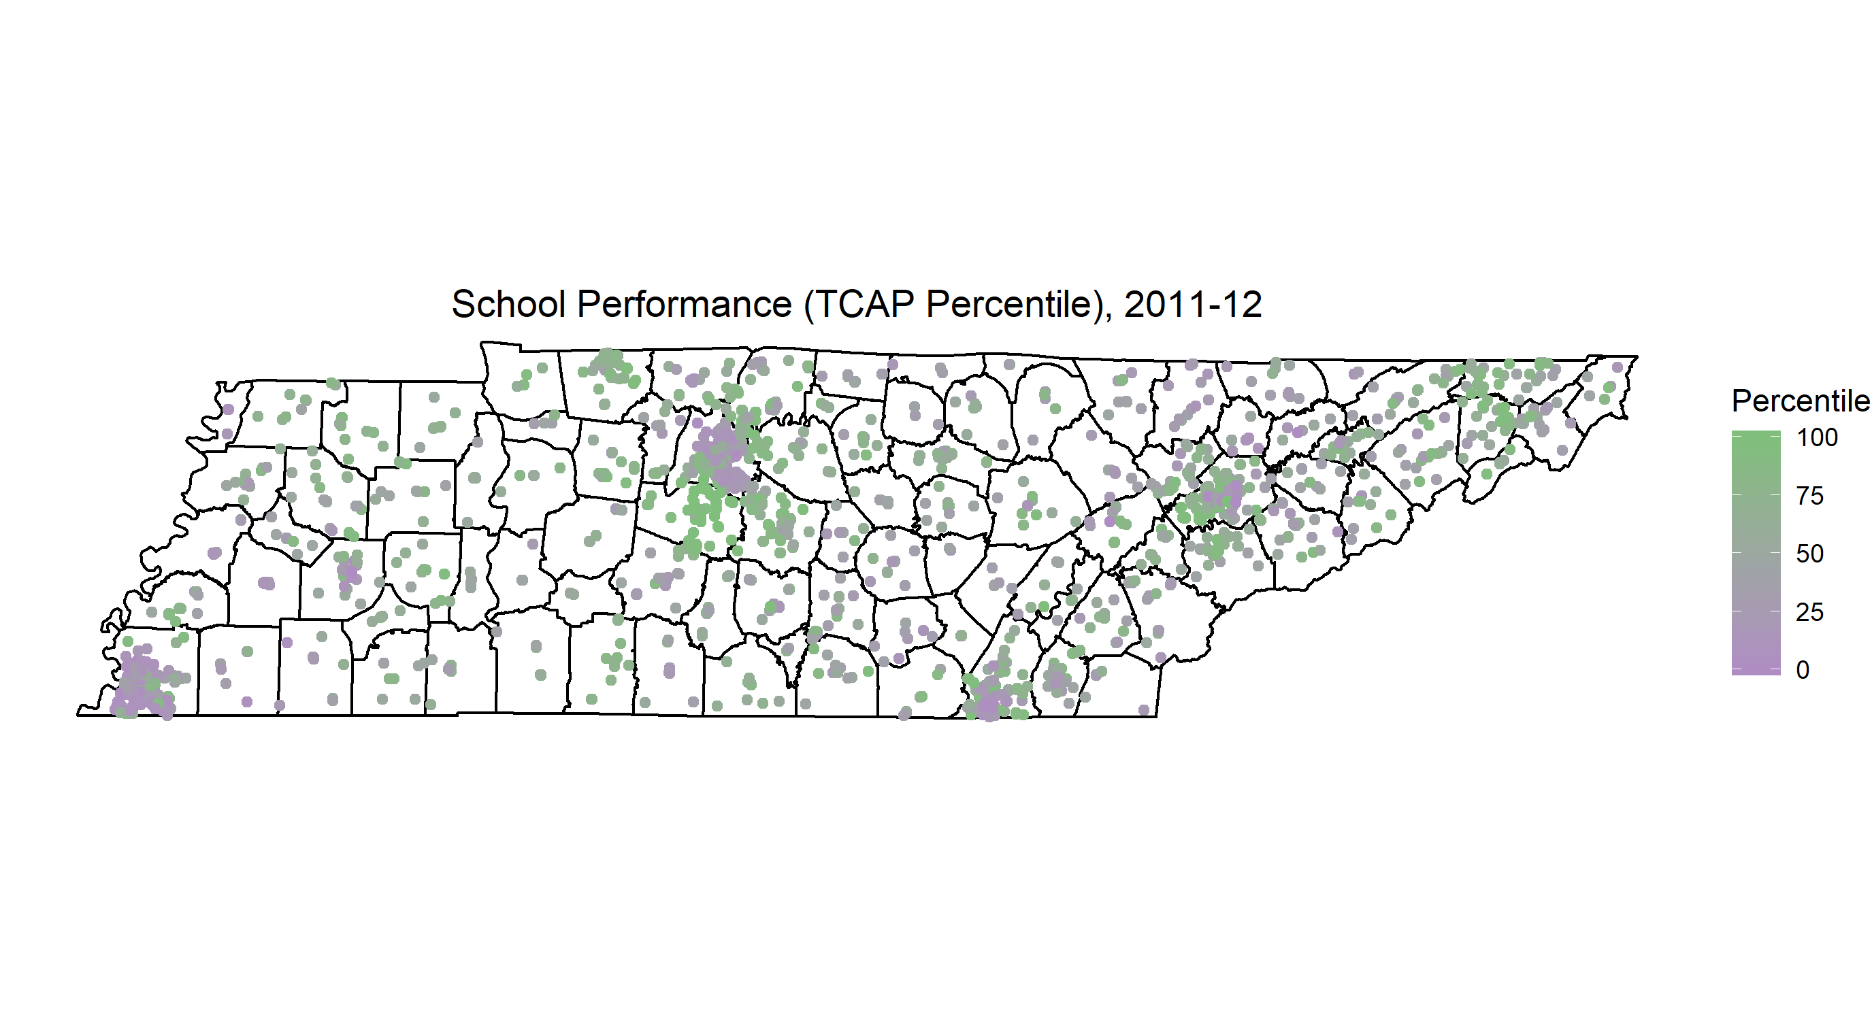

Slide 3
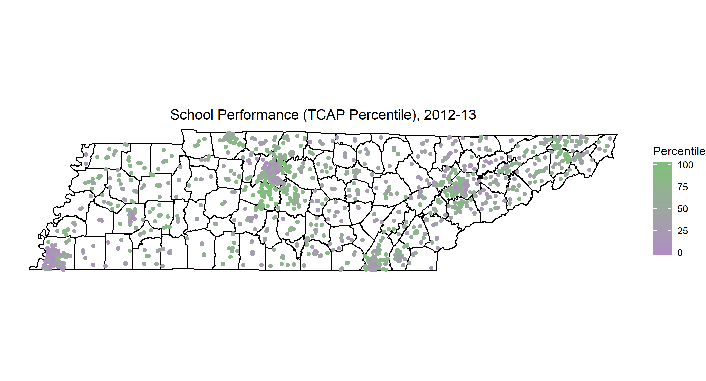

Slide 4
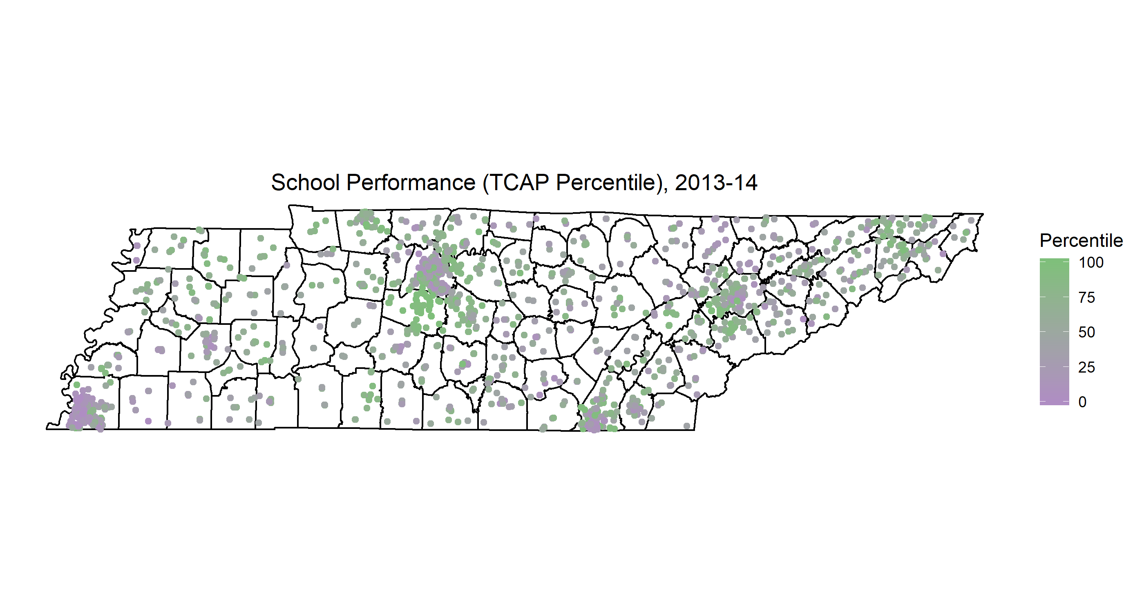

Slide 5
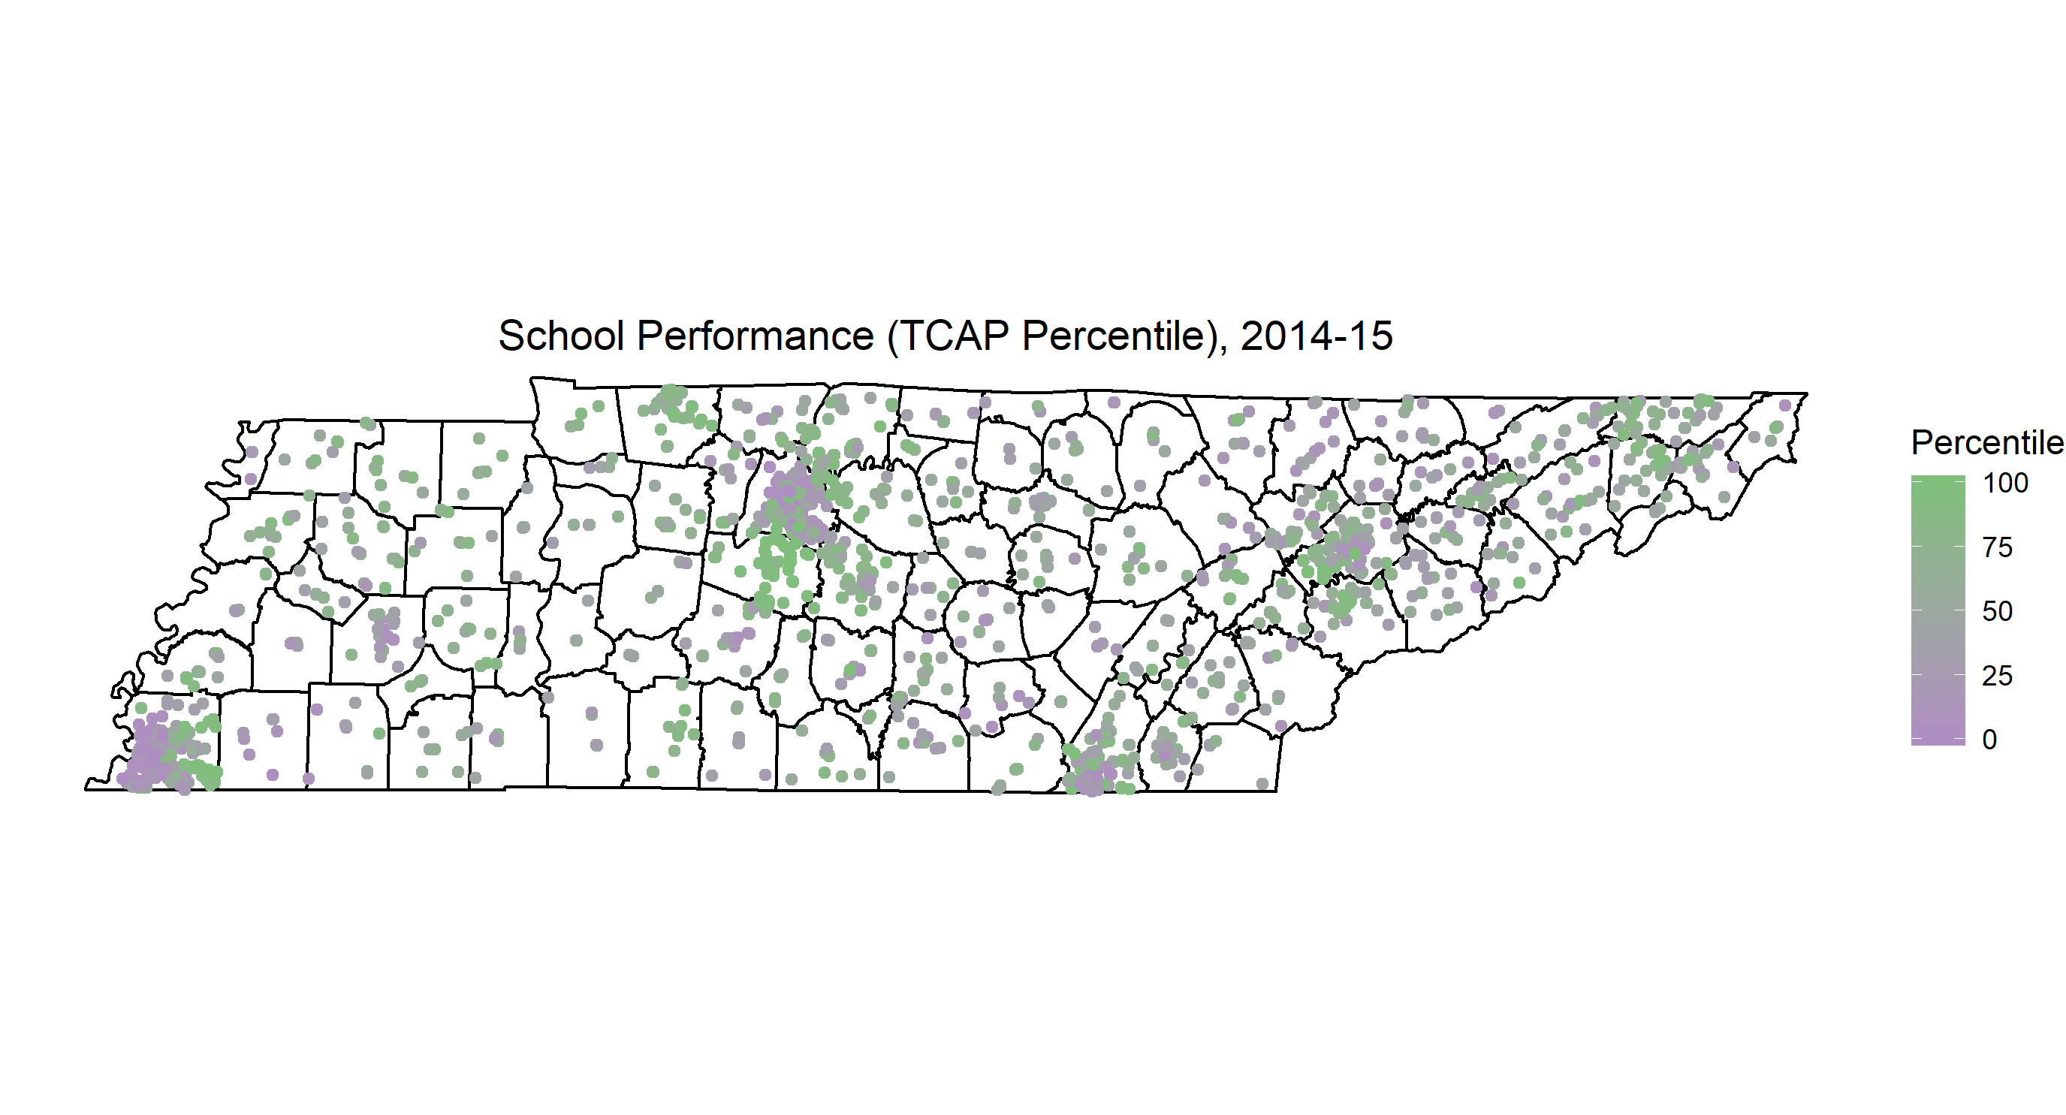

Slide 6
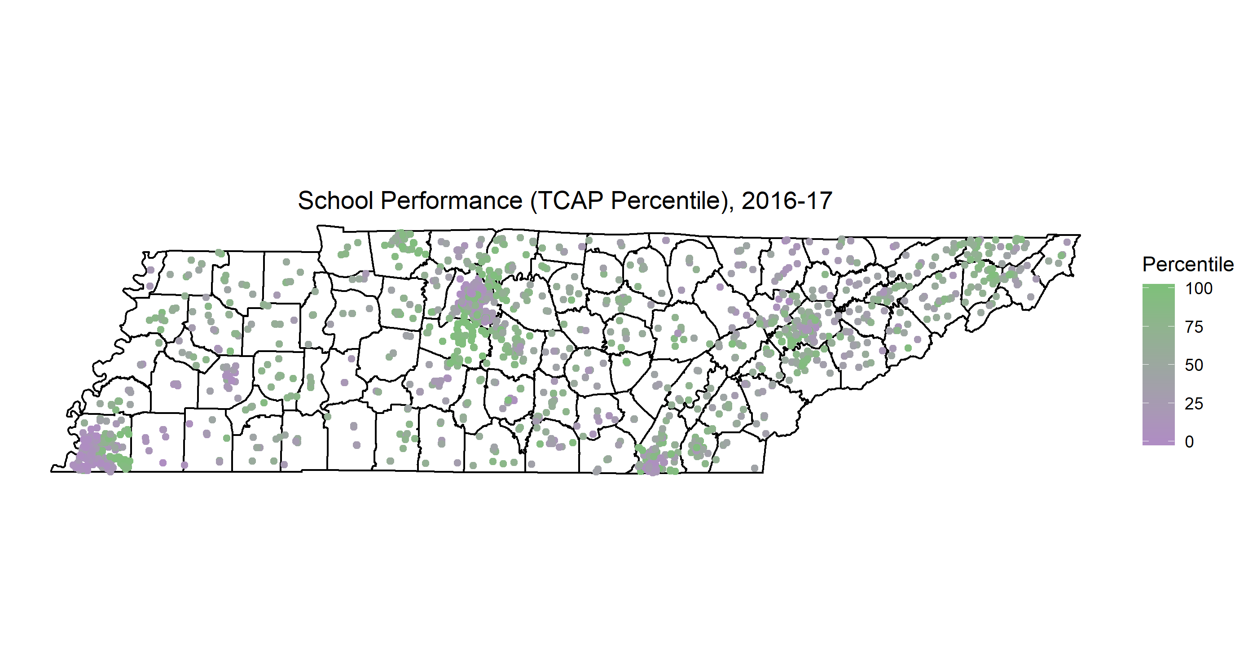

Slide 7


